Slide 1


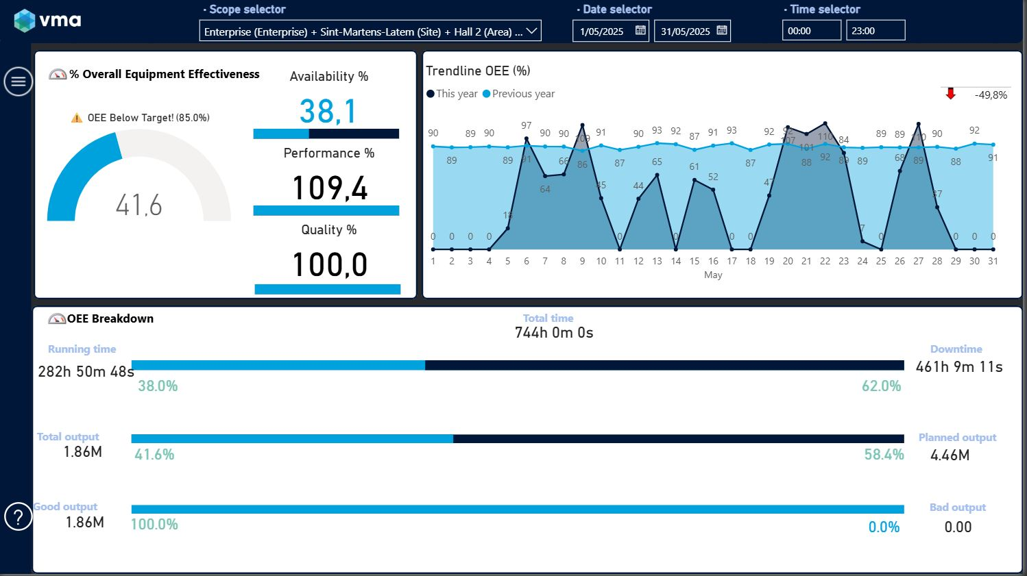
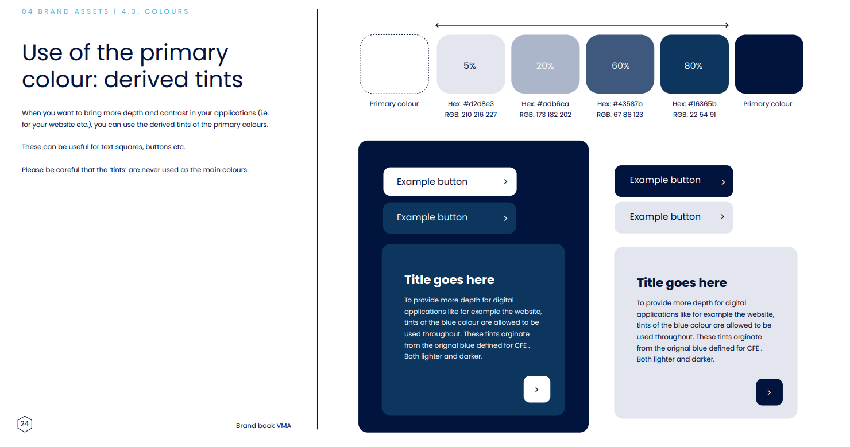
APP NAME
Type your search here
OEE
2%
Button
54,34%
Availability
65%
Button
2%
Performance
Button
88%
2%
Button
Quality
95%
OEE
+2%
2%
Trendline
OEE Breakdown
41,7%
Button
Running time
(200h 50m 48s)
(20h 5m 5s)
Down time
90%
Availability
38,1%
10%
Button
Performance
109,4%
Total Output
Planned Output
41%
59%
Quality
100,0%
Button
Good Output
Bad Output
Button
62%
Footer: Color: #00173a – font: Poppins
Notes:
Icons: https://www.iconpacks.net/free-icon/

Slide 2

Button
APP NAME
Type your search here
Button
OEE
2%
Button
54,34%
Availability
Button
65%
2%
Button
Performance
Button
88%
2%
Button
Quality
95%
2%
Trendline
OEE Breakdown
Running time
(200h 50m 48s)
(20h 5m 5s)
Down time
90%
10%
Total Output
Planned Output
41%
59%
Good Output
Bad Output
62%
Footer: Color: #00173a – font: Poppins

Slide 3
Button
APP NAME
Type your search here
Button
Button
OEE
2%
Button
54,34%
Availability
Button
Button
65%
2%
Button
Button
Performance
Button
Button
88%
2%
Button
Button
Quality
Button
95%
2%
Trendline
OEE Breakdown
Running time
(200h 50m 48s)
(20h 5m 5s)
Down time
90%
10%
Total Output
Planned Output
41%
59%
Good Output
Bad Output
62%
Footer: Color: #00173a – font: Poppins

Slide 4
APP NAME
Type your search here
Filter
Filter
Filter
Filter
OEE
2%
54,34%
Availability
Button
65%
2%
Button
Performance
Button
88%
2%
Button
Quality
95%
2%
Trendline
OEE Breakdown
Running time
(200h 50m 48s)
(20h 5m 5s)
Down time
90%
10%
Total Output
Planned Output
41%
59%
Good Output
Bad Output
62%

Slide 5
APP NAME
Type your search here
Filter
Filter
Filter
Filter
Button
OEE
2%
Button
54,34%
Button
Availability
65%
2%
Button
Performance
Button
88%
2%
Button
Quality
95%
2%
Trendline
OEE Breakdown
Running time
(200h 50m 48s)
(20h 5m 5s)
Down time
90%
10%
Total Output
Planned Output
41%
59%
Good Output
Bad Output
62%

Slide 6

APP NAME
Type your search here
Filter
Filter
Filter
Filter
OEE
2%
54,34%
Availability
Button
65%
2%
Button
Performance
Button
88%
2%
Button
Quality
95%
2%
Trendline
OEE Breakdown
Running time
(200h 50m 48s)
(20h 5m 5s)
Down time
90%
10%
Total Output
Planned Output
Onze oplossingen
Lorum ipsum
Lorum ipsum
41%
59%
VMA NV
Gebouwtechnieken
Lorum ipsum
Lorum ipsum
Kortrijksesteenweg 14b
Industrial Automation
Lorum ipsum
Lorum ipsum
Good Output
Bad Output
9830 Sint-Martens-Latem
Lorum ipsum
Lorum ipsum
Lorum ipsum
62%
info@vma.be
C 2025 VMA All rights reserved.

Slide 7
APP NAME
Type your search here
Filter
Filter
Filter
Filter
OEE
2%
54,34%
Availability
Button
65%
2%
Button
Performance
Button
88%
2%
Button
Quality
95%
2%
Trendline
OEE Breakdown
Running time
(200h 50m 48s)
(20h 5m 5s)
Down time
90%
10%
Total Output
Planned Output
41%
59%
Good Output
Bad Output
62%

Slide 8
APP NAME
Type your search here
Filter
Filter
Filter
Filter
OEE
2%
54,34%
Availability
Button
65%
2%
Button
Performance
Button
88%
2%
Button
Quality
95%
2%
Trendline
OEE Breakdown
Running time
(200h 50m 48s)
(20h 5m 5s)
Down time
90%
10%
Total Output
Planned Output
41%
59%
Good Output
Bad Output
62%

Slide 9
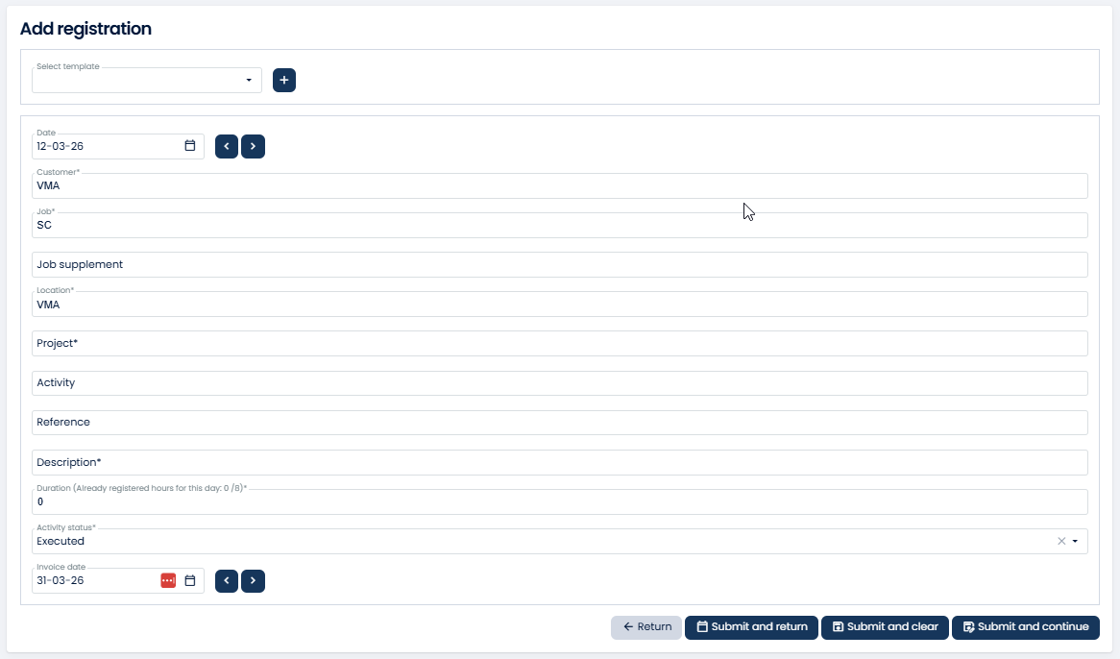
APP NAME
Type your search here

Slide 10
APP NAME
Type your search here

Slide 11
APP NAME
Type your search here
Filter
Filter
Filter
Filter
OEE
2%
54,34%
Availability
Button
65%
2%
Button
Performance
Button
88%
2%
Button
Quality
95%
2%
Trendline
OEE Breakdown
Running time
(200h 50m 48s)
(20h 5m 5s)
Down time
90%
10%
Total Output
Planned Output
41%
59%
Good Output
Bad Output
62%

Slide 12
CSS relative lengths
Specifies length/size based on other sizes
Element
em: relative to font size of current element (2em = 2 * current fontsize)
Rem = relative to font size of root element
% = relative to parent element
Viewport
Css has vw (ViewWidth) and vh (ViewHeight)
Using this instead of px, lets the size scale based on the available view.
1vw = 1% of visible view width
1vh = 1% of visible view height
---
Font-size could be
-vma-font-size-h1: min(3vw, 28px);
-vma-font-size-h2: min(2,5vw, 24px);
…etc
This lets font size scale up to a specified minimum
Clamp(min, scaling, max) is css function that can set range of growth
-vma-font-size-h1: clamp(26px, 3vw, 28px);
-vma-font-size-h2: clamp(22px, 2,5vw, 24px);
…etc
This can also be used for other sizes.
For header and icons:
Header => height: 3vw
Icon => height: clamp (80%, 3vw, 100%)
With the above setting the icon will remain maintain same scaling as header
Though for normal use case % is sufficient to have it match size of the header.
Component scalling
60px = 1.27cm
55px = 1.16cm
50px = 1.06cm
Fonts:
primary: Poppins
Fallback: Segoe UI
Fallback: Roboto
Fallback: ?
Fallback: ?
px icon = px bar
px icon = 90% px bar
px icon = 80% px bar
Main Title [H1] -> Size: 28
Section [H2] -> Size: 24
Title [H3] -> Size: 20
Subtitle [H4] -> Size: 18
Larger Text [H5] -> Size: 16
Large Text [H6] -> Size: 14
Regular text -> Size: 12
Main Title [H1] -> Size: 28
Section [H2] -> Size: 24
Title [H3] -> Size: 20
Subtitle [H4] -> Size: 18
Larger Text [H5] -> Size: 16
Large Text [H6] -> Size: 14
Regular text -> Size: 12

Slide 13
APP NAME
Type your search here
Hide app name
Fixed location/always in viewport
OEE
2%
Button
Fixed location/always in viewport
54,34%
Availability
65%
Button
2%
Performance
Button
88%
2%
Button
Quality
Flex layout/Panels move under each other
95%
OEE
+2%
2%
Trendline
OEE Breakdown
41,7%
Button
Running time
(200h 50m 48s)
(20h 5m 5s)
Down time
90%
Availability
38,1%
10%
Button
Performance
109,4%
Total Output
Planned Output
41%
59%
Quality
100,0%
Button
Good Output
Bad Output
Button
Fixed location/always in viewport
62%
Footer: Color: #00173a – font: Poppins
Notes:
Icons: https://www.iconpacks.net/free-icon/

Slide 14
Button
APP NAME
Type your search here
Button
Button
OEE
2%
Button
54,34%
Availability
Button
Button
65%
2%
Button
Button
Performance
Button
Button
88%
2%
Button
Button
Quality
Button
95%
2%
Trendline
OEE Breakdown
Fixed location/always in viewport On small screens when not enough place to show next to it’s previous one,
a sub menu comes on top of its parent menu When not enough height, add scrolling (up/down arrows) possibilities per menu
Running time
(200h 50m 48s)
(20h 5m 5s)
Down time
90%
10%
Total Output
Planned Output
41%
59%
Good Output
Bad Output
62%
Footer: Color: #00173a – font: Poppins

Slide 15
APP NAME
Type your search here
Filter
Filter
Filter
Filter
OEE
2%
54,34%
Availability
Button
65%
2%
Button
Performance
Button
88%
2%
Button
Quality
95%
2%
Fixed location, starts from the bottom
Apply a flex layout, so that each ‘block’ gets rendered according to its space on next row(s)
When not enough place in height, add scrolling (up/down arrows) possibilities
Trendline
OEE Breakdown
Running time
(200h 50m 48s)
(20h 5m 5s)
Down time
90%
10%
Total Output
Planned Output
Onze oplossingen
Lorum ipsum
Lorum ipsum
41%
59%
VMA NV
Gebouwtechnieken
Lorum ipsum
Lorum ipsum
Kortrijksesteenweg 14b
Industrial Automation
Lorum ipsum
Lorum ipsum
Good Output
Bad Output
9830 Sint-Martens-Latem
Lorum ipsum
Lorum ipsum
Lorum ipsum
62%
info@vma.be
C 2025 VMA All rights reserved.

Slide 16
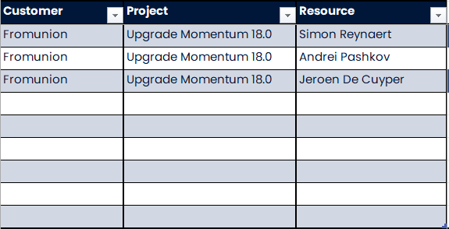
Grid

Slide 17
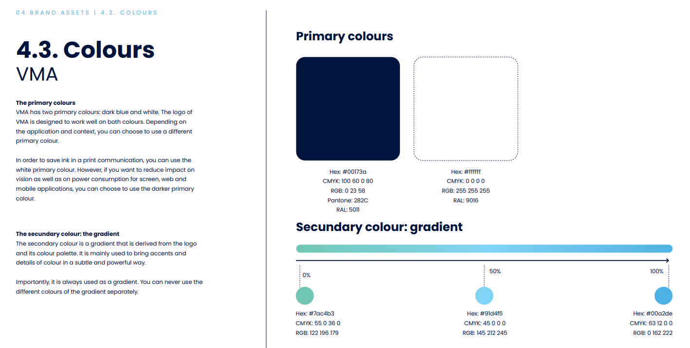

Slide 18

Colors
HTML #00173A
RGB 0,23,58
CMYK 23,14,0,77
HTML #97D6F1
RGB 151,214,241
CMYK 36,11,0,6
HTML #54b2e5
RGB 84,178,229
CMYK 63,22,0,10

Slide 19

VMA Colors
HTML #2388C9
RGB 35,137,201
CMYK 83,32,0,21
HTML #1EBBEE
RGB 30,187,238
CMYK 82,21,0,7
HTML #91D5F5
RGB 145,213,245
CMYK 41,13,0,4
HTML #0FADE4
RGB 15,173,228
CMYK 93,24,0,11
HTML #218FCF
RGB 33,143,207
CMYK 84,31,0,19
HTML #72C0EB
RGB 114,192,235
CMYK 51,18,0,8
HTML #0FA7AB
RGB 15,167,171
CMYK 91,2,0,33
HTML # 14A1DC
RGB 20,161,220
CMYK 91,27,0,14
HTML #79C4B1
RGB 121,196,177
CMYK 38,0,10,23
HTML #1A7FC3
RGB 26,127,195
CMYK 87,35,0,24
HTML #1A8E93
RGB 26,142,147
CMYK 82,3,0,42
HTML #18A781
RGB 24,167,129
CMYK 86,0,23,35
HTML #129FA7
RGB 18,159,167
CMYK 89,5,0,35
HTML #15878E
RGB 21,135,142
CMYK 85,5,0,44
HTML #1B8779
RGB 27,135,121
CMYK 80,0,10,47

Slide 20

CFE Colors
HTML #14813d
RGB 20,129,61
CMYK 84,0,53,49
HTML #20a13c
RGB 32,161,60 CMYK 80,0,63,37
HTML #6eb54f
RGB 110,181,79
CMYK 39,0,56,29
HTML #93bf4c
RGB 147,191,76
CMYK 23,0,60,25
HTML #1fa149
RGB 31,161,73
CMYK 81,0,55,37
HTML #138337
RGB 19,131,55
CMYK 85,0,58,49
HTML #7bc5b4
RGB 123,197,180
CMYK 38,0,9,23
HTML #44674f
RGB 68,103,79 CMYK 34,0,23,60
HTML #10a4a8
RGB 16,164,168
CMYK 90,2,0,34
HTML #6f64a9
RGB 111,100,169
CMYK 34,41,0,34
HTML #198b8b
RGB 25,139,139
CMYK 82,0,0,45
HTML #255a40
RGB 37,90,64 CMYK 59,0,29,65
HTML #2d3c91
RGB 45,60,145
CMYK 69,59,0,43
HTML #1c54a1
RGB 28,84,161
CMYK 83,48,0,37
HTML #123f80
RGB 18,63,128
CMYK 86,51,0,50
HTML #54b2e5
RGB 84,178,229
CMYK 63,22,0,10
HTML #263377
RGB 38,51,119
CMYK 68,57,0,53
HTML #4563ab
RGB 69,99,171
CMYK 60,42,0,33

Slide 21
Font
Agenda
Title
Poppins, 40pt
Poppins, 60pt
Subtitle
Poppins, 25pt
Section Title
Presentation Title
Poppins, 44pt
Poppins, 12pt
Large text
Poppins, 16pt
Normal Text
Poppins, 13pt

Slide 22
120%
Rgb: 0,17,41 #001129
Prefered MOM team choise

Slide 23
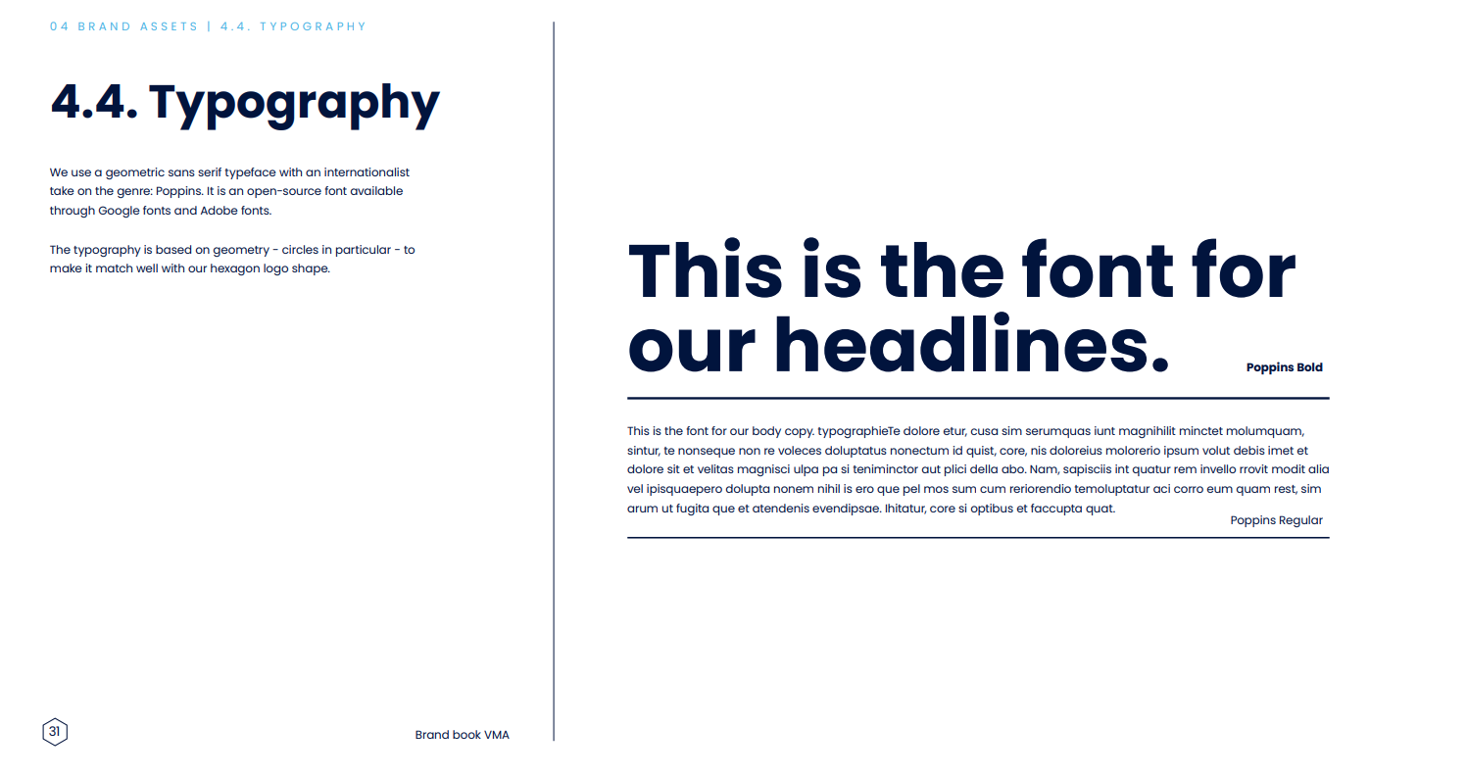

Slide 24
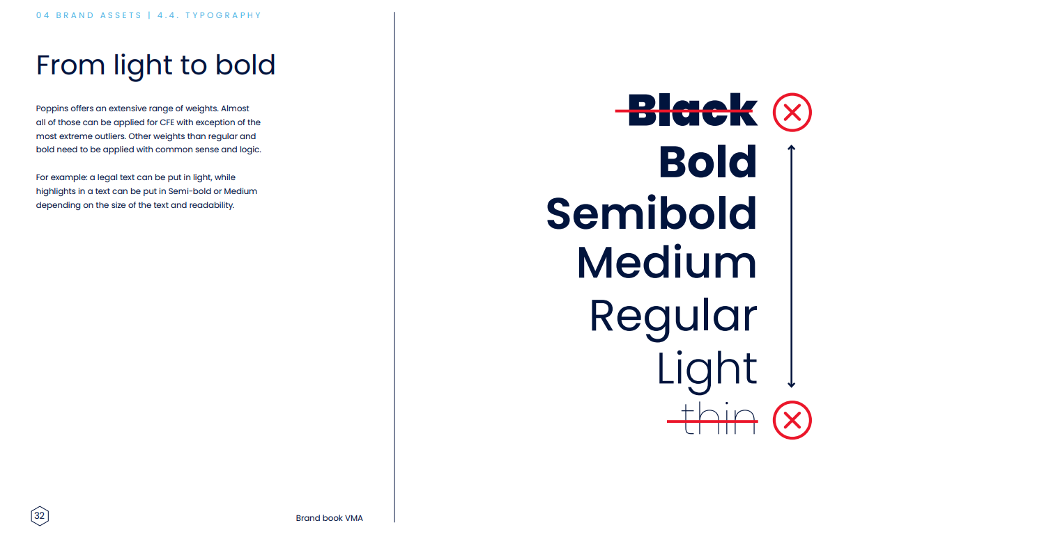

Slide 25
APP NAME
Type your search here
OEE
2%
Button
Button
54,34%
Availability
65%
Button
Button
2%
Performance
Button
Button
88%
2%
Button
Button
Quality
95%
2%
Trendline
OEE Breakdown
Running time
(200h 50m 48s)
(20h 5m 5s)
Down time
90%
10%
Total Output
Planned Output
41%
59%
Good Output
Bad Output
62%
Footer: Color: #00173a – font: Poppins

Slide 26
Button
APP NAME
Type your search here
OEE
2%
Button
Button
54,34%
Availability
65%
Button
Button
2%
Button
Performance
Button
88%
2%
Button
Quality
95%
2%
Trendline
OEE Breakdown
Running time
(200h 50m 48s)
(20h 5m 5s)
Down time
90%
10%
Total Output
Planned Output
41%
59%
Good Output
Bad Output
62%
Footer: Color: #00173a – font: Poppins

